Slide 1
Deendayal Antyodaya Yojana National Urban Livelihoods Mission Bihar City Mission Manager Review Meeting
Vision EIS Consulting Pvt. Ltd.
(Project Management Consultant)
for
Urban Development and Housing Department Government of Bihar
Date: 30th March 2019

Slide 2
Points for Discussion:
S.No | Points to Discuss | Comments | Remarks
1 | We were instructed from the department to conduct resurvey in the ULBs within an interval of six months to check the difference in the numbers of homeless population as they are seasonal in nature. | ULBs shall arrange to conduct re-survey of homeless at their respective ULBs and furnish the reports to PMC whenever asked. | As per the last report furnished to PMC, final no. of homeless as per survey is 10,253.
2 | We were instructed from the department that the shelters at 12 Nagar Nigams and rest ULBs shall be taken up on priority basis for mapping. | Mapping of shelters in Nagar Nigams and ULBs have been done by few CMMs and the reports were shared with PMC. Not all CMMs have furnished the data. | We have furnished the data to department but few changes in Map Legend has been suggested by them. The same will be shared with CMMs sooner and based on that ULBs having shelters must map them and send us the data by 10th April 2019.

Slide 3
Points for Discussion:
S.No | Points to Discuss | Comments | Remarks
3 | We were instructed from the department that Proper training and monitoring of the Municipal officials, ward councillors and ALOs are required for proper functioning of the shelters. | Letter has been issued to ULBs in this regard (Letter No. 739 dated 11.03.2019). | CMMs must ensure that the training has/shall be organised and arrange to share the Minutes with PMC.
4 | As operations and management of the shelters were being done by the Area Level Organisations of the local SHGs, it was instructed that timely payment should be made to them so as to avoid any malpractices in the shelters. | Letter has been sent to ULBs vide Letter No. 739 dated 11.03.2019. | CMMs shall have a check on regular/monthly payment of ALOs. Payments if pending shall be followed up with Municipal Commissioner, EO and ensure it is done, else, the same shall be reported to PMC for further course of actions.
5 | Encroachment at SUH shall be removed. | CMMs shall mark out such SUH which are encroached and occupied. The same shall be reported to Municipal Commissioner, EO and PMC. | Once such reports are received, PMC will look into it and assist CMMs for solutions in removing encroachment from SUH.

Slide 4
Points for Discussion:
S.No | Points to Discuss | Comments | Remarks
6 | Both male and female caretakers to be provided at the shelters to ensure safety as females also stay in good numbers. | Letter has been sent to ULBs vide Letter No. 739 dated 11.03.2019. | No female caretaker is deployed at night. CMMs shall follow up for the same and make sure female care taker is deployed at day and night at shelters.
7 | Since permanent shelters can only serve the purpose, PMC–DAY NULM was directed to help the Nagar Nigam in identifying lands for the construction of new SUH. | Identification of land shall be made as per the SUH guidelines and shall be immediately intimated to PMC for further course of action. Need list of 22 sites that have been identified by Patna Municipal Commissioner. Need such lists from other ULBs as well.
8 | It was informed to PMC that in Begusarai construction of New Shelter shall start as the land has been identified near bus stand. | CMM shall confirm the status of tender for construction of SUH has been floated or not and any other development if made.

Slide 5
Points for Discussion:
S.No | Points to Discuss | Comments | Remarks
9 | Alternate sites have been identified in Saharsa for construction of SUH. | CMM to confirm if NOC been received.
10 | At Gopalganj, land has been identified and NOC has been received. | CMM shall confirm the status of tender for construction of SUH has been floated or not and any other development if made.
11 | Rajgir & Aurangabad have been instructed to find suitable land or propose alternate sites/buildings for establishing shelters in the town by May, 2019. | CMM of Rajgir & Aurangabad shall please confirm the status.
12 | It has been noticed that CCTV’s in most of the SUH have not been installed. | As per the SUH guidelines please make sure CCTV’s are installed at the earliest. | Need report on the same by 10th April 2019.

Slide 6
Points for Discussion:
S.No | Points to Discuss | Comments | Remarks
13 | As per SUH guidelines, Shelter Management Committee must be formed at every ULBs where we have operational shelters. | SMC has not been formed in most of the ULBs where shelters have been made operational. | Please ensure SMC is formed as per the guidelines and regular meetings are organised. Minutes of meeting of the same shall be shared with PMC as these needs to be compiled, submitted to department and “Shelter Monitoring Committee” (a team formed by Supreme Court for monitoring functionality of SUH).
14 | MIS updation on NULM Portal. | It has been observed that after too many reminders via email and Whatsapp few CMM didn't update SUH details on NULM portal. | Current month March is the deadline for updation of component details in portal. Henceforth, no back dated data will be allowed to enter data in portal post 31st March 2019.

Slide 7
Points for Discussion:
S.No | Points to Discuss | Comments | Remarks
15 | Wrong entries in NULM portal. | While going through the NULM portal too many wrong entries were found. Two fields are as mentioned: Proposal wrong entry. SUH profile entry. The same were intimated to respective CMMs for correction but it wasn’t done. | CMMs shall understand the criticality of any tasks which are requested to be done. Hence, request you all not to ignore such instructions but comply.

Slide 8
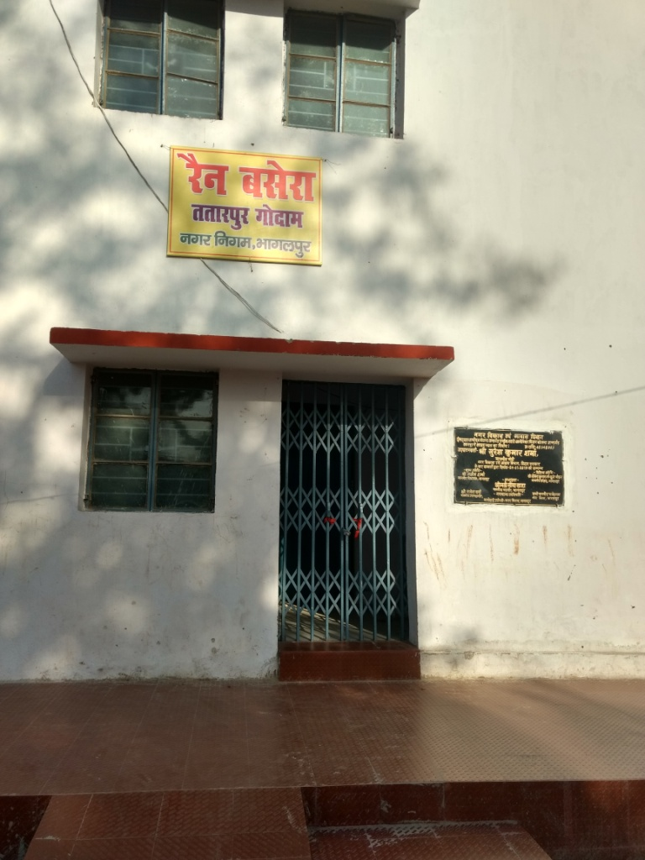
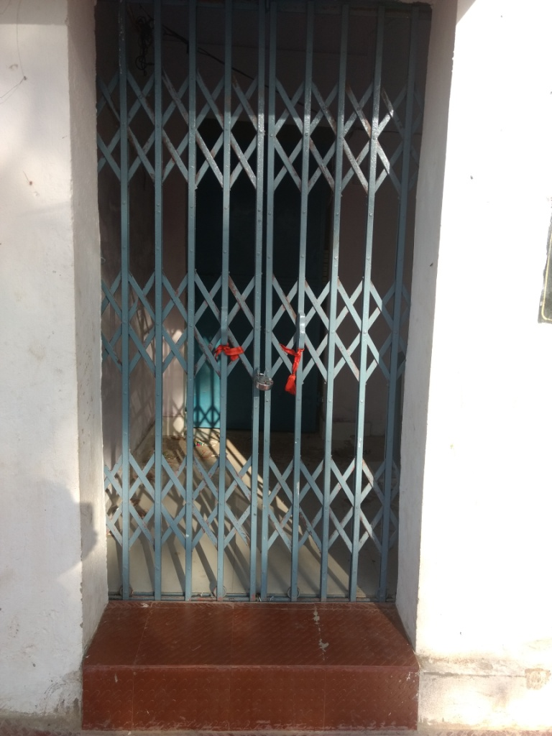
Bhagalpur SUH Pics (Tatarpur Godown):

Slide 9
Table 1: Status on new SUH sanctioned under DAY-NULM
Sl No: | Name of ULB |  | No. of SUH sanctioned | Status - 2019
Operational SUH: 22
1 |  | Hajipur | 1 | Operational
2 |  | Supaul | 1 | Operational
3 |  | Arwal | 1 | Operational
4 |  | Biharsharif | 1 | Operational
5 |  | Sitamarhi | 1 | Operational
6 |  | Gaya | 1 | Operational
7 |  | Sasaram | 1 | Operational
8 |  | Madhepura | 1 | Operational
9 |  | Bhabua | 1 | Operational
10 |  | Arrah | 1 | Operational
11 |  | Buxar | 1 | Operational
12 |  | Lakhisarai | 1 | Operational
13 |  | Kishanganj | 1 | Operational
14 |  | Purnia | 2 | Operational
15 |  | Araria | 1 | Operational
16 |  | Banka | 1 | Operational
17 |  | Bhagalpur | 1 | Operational
18 |  | Muzaffarpur | 1 | Operational
19 |  | Sheikhpura | 1 | Operational
20 |  | Bettiah | 1 | Operational
21 |  | Nawada | 1 | Operational

Slide 10
Table 1: Status on New SUH sanctioned under DAY-NULM
Sl No: | Name of ULB | No. of SUH sanctioned | Status - 2019
SUH to be made Operational: 09
22 | Chhapra | 1 | Construction Completed. To be made operational by 15th April 2019.
23 | Darbhanga | 1 | Construction Completed.
24 | Jehanabad | 1 | Construction Completed.
25 | Jamui | 1 | Construction Completed.
26 | Amarpur | 1 | Construction Completed.
27 | Sultanganj | 1 | Construction Completed.
28 | Naugachia | 1 | Construction Completed.
29 | Katihar | 1 | Construction Completed. Plumbing & Electrification work is pending. Tender to float.
30 | Madhubani | 1 | Construction Completed. Plumbing & Electrification work is pending. Tender to float.
SUH under Construction: 07
31 | Khagaria | 1 | Near completion. Plaster, whitewash & electrification works are pending.
32 | Samastipur | 1 | Constructed till 1st Floor.
33 | Sheohar | 1 | 1st Floor construction under process.
34 | Lalganj | 1 | Only structure is made ready. Contractor is working in slow pace.
35 | Gogri Jamalpur | 1 | 1st Floor construction completed. Contractor is working in slow pace.
36 | Warsaliganj | 1 | 2nd Floor construction under process.
37 | Jhajha | 1 | 1st Floor construction under process.

Slide 11
Table 1: Status on New SUH sanctioned under DAY-NULM
Sl No: | Name of ULB | No. of SUH sanctioned | Status - 2019
Land identified for Construction of New SUH: 07
38 | Begusarai | 1 | Land identified near old bus stand.
39 | Motihari | 1 | Land identified in Sadar hospital.
40 | Siwan | 1 | Land identified near old bus stand.
41 | Sasharsa | 1 | Land identified.
42 | Gopalganj | 1 | Land identified.
43 | Munger | 1 | Land identified in ward 32 near Lallu Pokhar. NOC awaited.
44 | Patna | 1 | 22 sites have been identified.
Land yet not identified for Construction of New SUH: 02
45 | Aurangabad | 1 | Land Not identified.
46 | Rajgir | 1 | NOC awaited.
Other : 02
47 | Bodhgaya | 1 | Court case
48 | Haweli Kharagpur | 1 | Tender Under Process. (retendering has to be done)
Summary of New SUH sanctioned:
Operational | 22
To be made operational | 9
Under Construction | 7
Land Identified | 7
Land Not Identified | 2
Tendering/Court case | 2
Total | 49

Slide 12
Table : Status on Existing SUH taken for O&M
S. No. | Name of ULB | Existing SUH (O&M) | Operational | Remarks
1 | Arrah | 3 | 3
2 | Bettiah | 1 | 1
3 | Bhagalpur | 6 | 6
4 | Biharsharif | 2 | 2
5 | Chhapra | 1 | 1
6 | Darbhanga | 2 | 2
7 | Gaya | 6 | 6
8 | Hajipur | 1 | 1
9 | Motihari | 1 | 1
10 | Muzaffarpur | 9 | 9
11 | Siwan | 1 | 1
12 | Danapur | 1 | 1
13 | Dehri | 1 | 1
14 | Sheikhpura | 1 | 1
15 | Purnia | 2 | 2

Slide 13
Table : Status on Existing SUH taken for O&M
Sl. No: | Name of ULB | Existing SUH (O&M) | Operational | Remarks
16 | Patna | 13 | 3 | 10 to be refurbished. (PMC is planning to demolish the dilapidated structures and construct new one.
17 | Saharsa | 1 |  | 01 to be refurbished. Tender published by ULB for refurbishment of Shelter.
18 | Katihar | 1 |  | 01 to be refurbished
19 | Munger | 2 | 2
Total |  | 55 | 43 | 12
Summary:
Operational | 43
Refurbishment | 12
Total | 55

Slide 14
Thank You….

