Slide 1
SULM –Bihar
State Urban Livelihood Mission -Bihar
URL : http://sulmbihar.in/

Slide 2
Agenda
1.
Introduction
2.
Website Overview
3.
Focus Modules
4.
MIS (Management Information System)

Slide 3
INTRODUCTION
Brief Introduction of SULM- Bihar
The National Urban Livelihoods Mission (NULM) is a central Govt. scheme which is run in Bihar with name of SULM-Bihar.
To reduce poverty and vulnerability of urban poor households by enabling them to access gainful self employment and skilled wage employment opportunities, resulting in an appreciable improvement in their livelihoods on sustainable basis through building strong grassroots level institutions of the poor.
The mission would aim at providing shelters equipped with essential services to the urban homeless in a phased manner.

Slide 4
Bifurcation of SULM Portal
Front - End
MIS
Management Information system

Slide 5
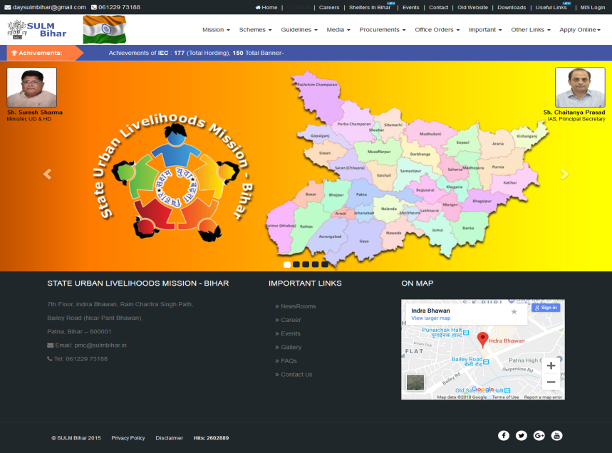
SULM Website Overview
Front-End

Slide 6
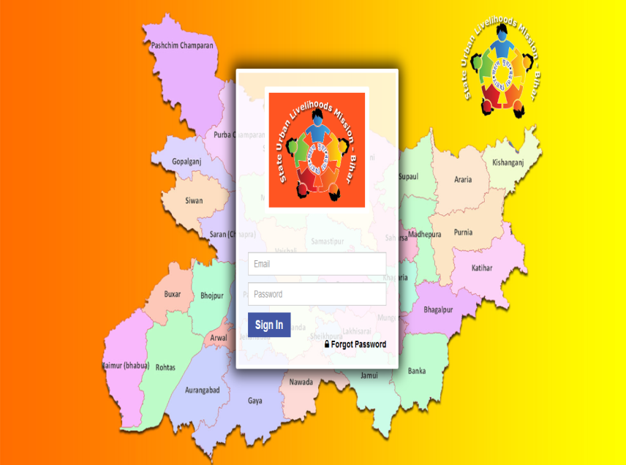
SULM Website Overview
MIS

Slide 7
Front-End View (SULM Portal)
Front – End
Front-end of SULM Portal consists the following:
Components of SULM
Our Team
Contact details of SMM (State Mission Manager)
Contact details of CMM (City Mission Manager)
Tickets.
Notice and News
Gallery etc.

Slide 8
Components of SULM
EST&P
SM&ID
SUSV
SEP
SUH
CB&T
IEC

Slide 9
MIS
Management Information System
MIS access on Dashboards and Reports has different rights based on approvals.
Such as
STP (Skill Training Provider)
ULB (Urban Local Body),
SMM (State Mission Manager)
Team Leader
Project-Coordinator
Principle Secretary
RO (Resource Organizer) etc.

Slide 10
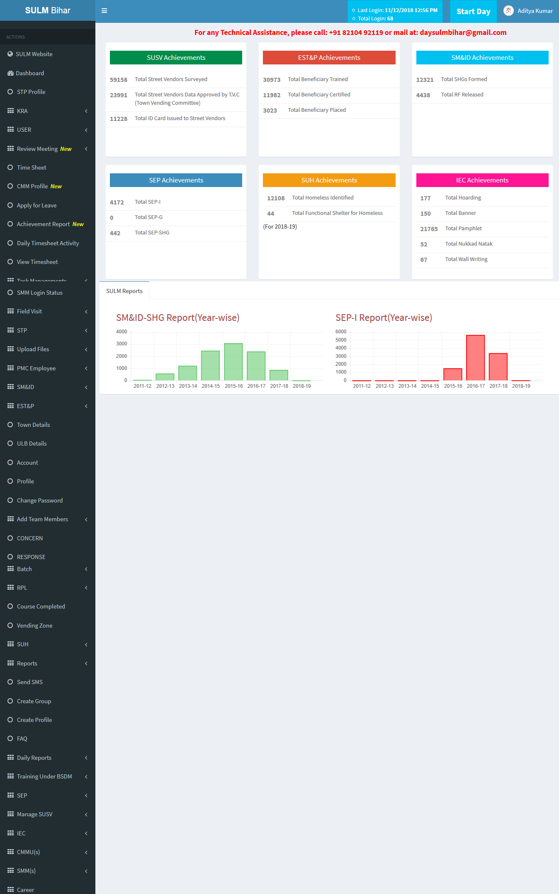
MIS
Management Information System
Dashboard Limitation
STP (Skill Training Provider)
Dashboard for agency to provide training to beneficiaries.
ULB (Urban Local Bodies)
Dashboard for CMMs at different ULBs.
SMM (State Mission Manager)
Dashboard for SMMs for different components.
Team Leader
Dashboard for Team Leader. Team leader can assign task and view the reports on all components.
Project Coordinator
Dashboard for Project Coordinator. Project Coordinator can assign tasks and view the reports on various components.
Principle Secretary (PS)
Dashboard for PS Sir. He can view the reports on various components.

Slide 11
Area to Focus on MIS-SULM
Timesheet
Reports
We have reporting module prepared for every component where every employees can download all sort of reports depending upon the rights assi
gned.
To enter daily activities/tasks done in TIMELINE on portal.
CMM Profile
Self Assign Task
Every CMM needs to fill up their own details so that it is easier for every employees and management to tracks records of CMM.
Every employees shall assign their own tasks to do on daily basis and shall complete within timeframe as per the assignment.
IEC
SUSV & SUH
Every CMM and SMM will have to enter the details of wok done. This helps our management to extract updated reports.
Every CMM and SMM will have to enter the details of wok done. This helps our management to extract updated reports.

Slide 12
Area to Focus on MIS-SULM
NULM details??????

Slide 13
Thanks for your time.

